Slide 1
Hello Aloe
For plant people….
Sort of.

Slide 2
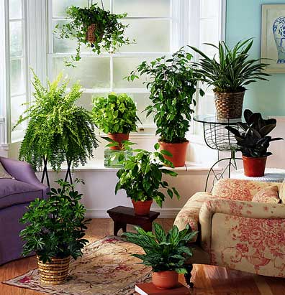
Does this look like your apartment?

Slide 3
No?

Slide 4

This more like it?

Slide 5
Great! I have an app for YOU

Slide 6
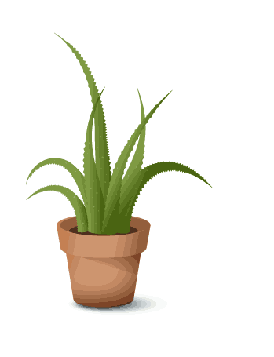
Hello Aloe
(for budding plant people)

Slide 7
I get it, you’re a busy person and lets face it, keeping a house plant alive isn’t really your MO.
Hello Aloe is a friendly widget that will hang out on your home screen and gently remind you when it’s time to water your plants.
After some painless initial setup you are on your way. Hello Aloe will take in consideration the weekly weather patterns in your city and the watering schedule of your plant to figure out when it’s time to remind you to water the plant.

Slide 8
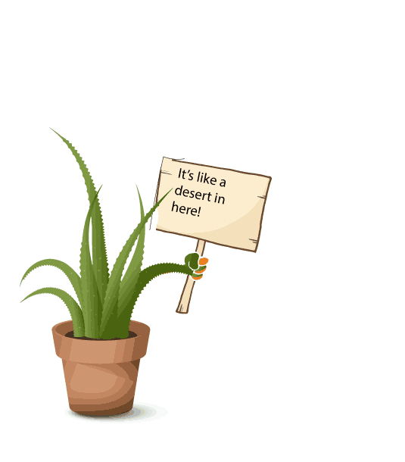
A gentle reminder

Slide 9
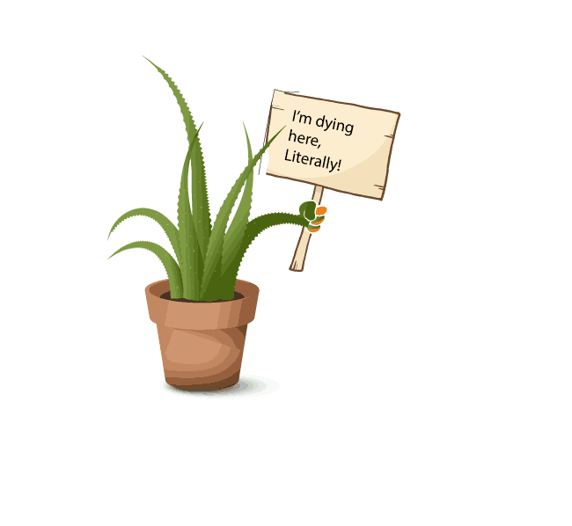
How ‘bout that drink!?

Slide 10
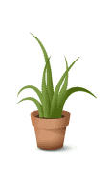
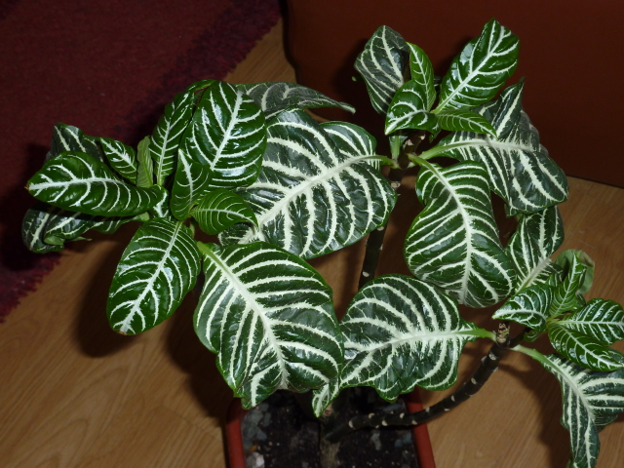
Add a plant
Update your plants
Your Plants
Seymore
Likes shade and water every 7 days

Slide 11


